Slide 1
Shell Bootcamp 2024 3 Reflections for Week 2
Puneet Kumar Sharma
Date : 06-Sep-2024

Slide 2

About Me
The more you know, The more you realize that you know nothing

Slide 3

My learnings from this week!

Slide 4
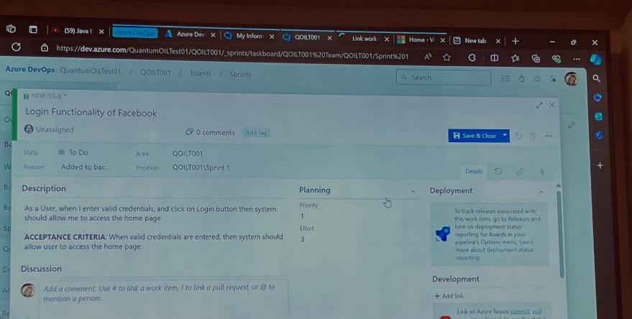
BA & Agile | My takeaways
In this week’s BA & Agile Class I learned the importance of Business Analyst and Software Testing.
The key takeaway from BA & Agile class is the importance of documentation in software engineering and why it is important to clearly define and approve each and every requirement.

Slide 5
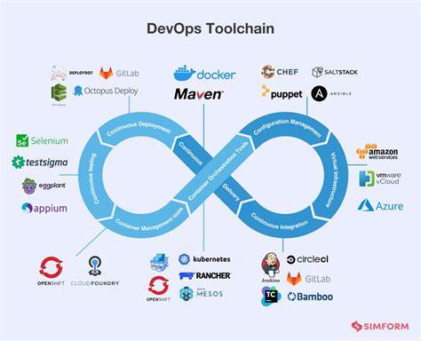
DevOps | My takeaways
In this week’s DevOps Class, I learned the importance, principles and benefits of DevOps not just as a framework but as a work culture.
The key takeaways from this week’s DevOps class are the tools which are used in continues integration and continues delivery.

Slide 6
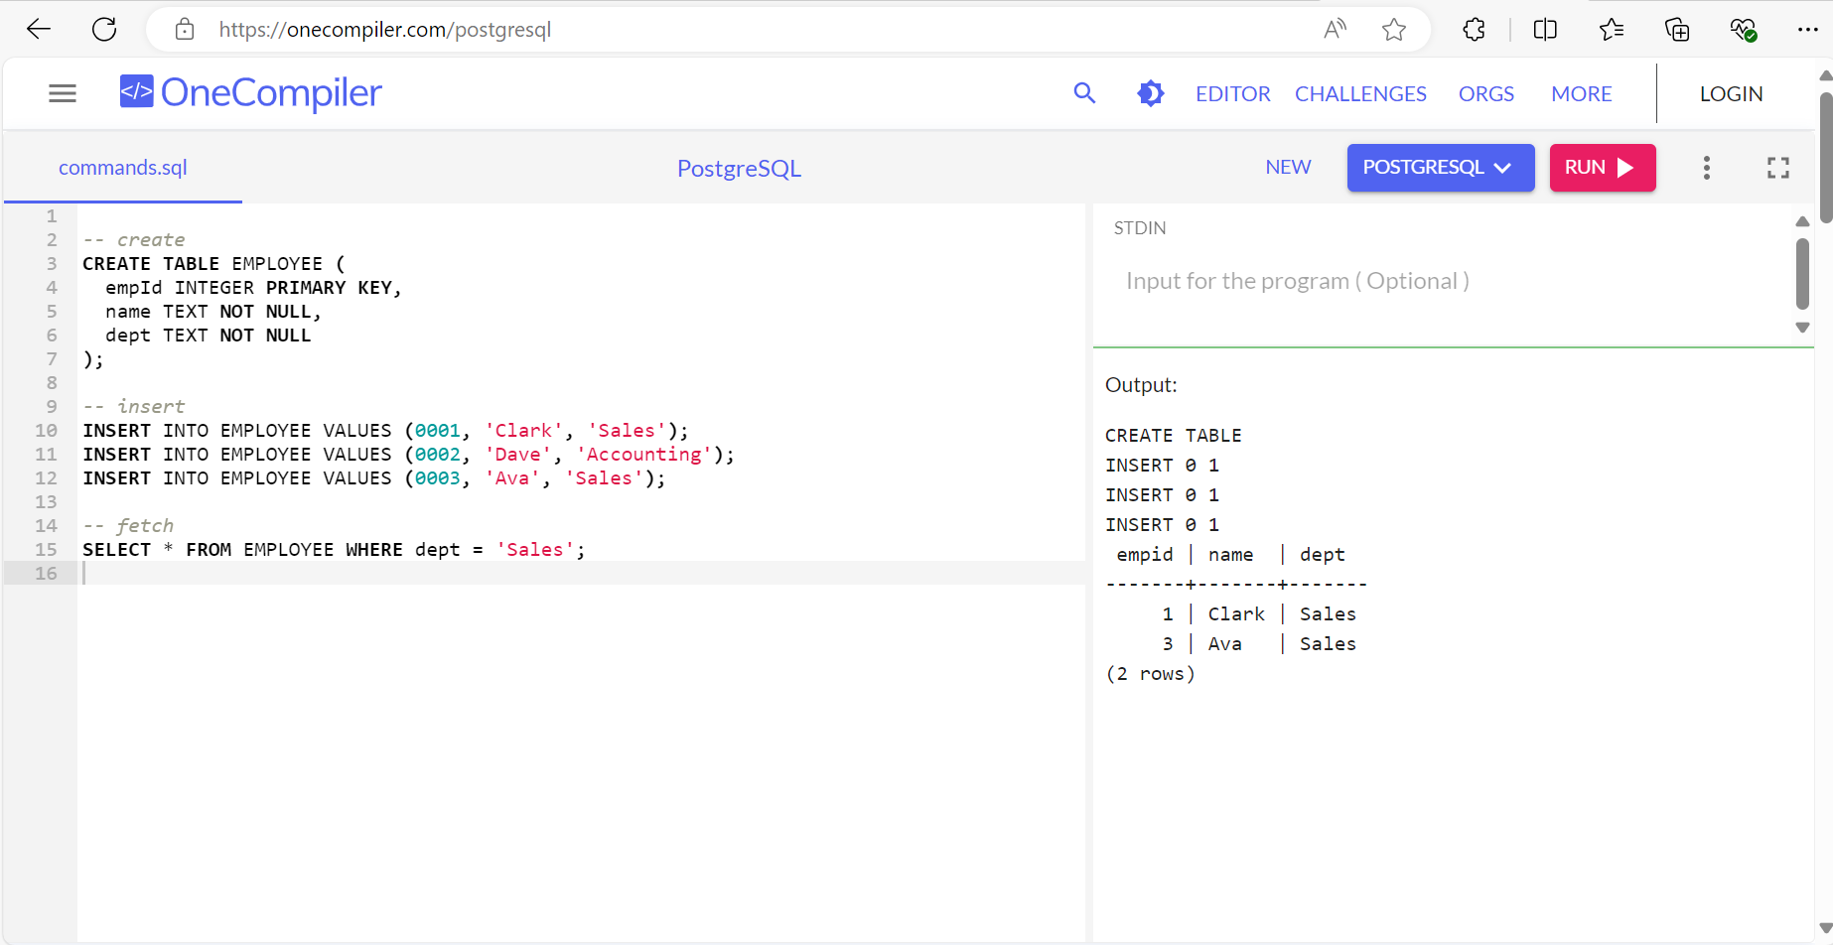
DBMS | My takeaways
In this week’s DBMS class I learned why it is important to have an efficient Database Management System, and why PostgreSQL is used in the industry.
The key takeaway for me was the structure in which SQL queries are used and how we can write efficient SQL queries.

Slide 7

Relevance of learnings for my organization

Slide 8
BA & Agile | Relevance for Shell
Shell implements Agile Scrum in its projects which is a modern agile framework as well as Shell employs Business Analysts to engage with the stakeholders particularly with the client.
Shell benefits through Agile Scrum by allowing its projects to rapidly adapt to the requirements of its clients.

Slide 9
DevOps | Relevance for Shell
Shell implements DevOps by implementing continuos monitoring of its oil rigs which are constantly streaming tons of data live to its monitoring servers.
Shell benefits from DevOps by utilizing continuous monitoring to detect any defects in its onsite and edge equipments early and perform preventative maintenance.

Slide 10
DBMS | Relevance for Shell
Shell generates large amounts of data from its edge equipments through its IoT sensors which are streamed to monitoring servers and are stored in database servers as logs, having an efficient database management is crucial for Shell.
Shell benefits from DBMS by utilizing the most modern and efficient DBMS such as PostgreSQL which provides low latency and fast response time.

Slide 11

Challenges in implementing learning

Slide 12
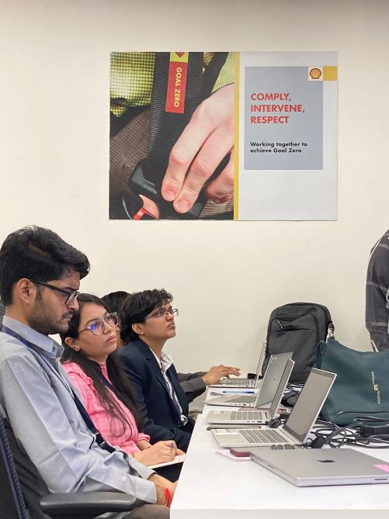
Challenge faced while implementing BA & Agile
The challenge that I faced while implementing learnings in BA & Agile is the difficulty in drafting detailed and comprehensive documents.
I plan to overcome this challenge by allowing myself to realize the importance of documentation and why it is important in software development life cycle.

Slide 13
Challenge faced while implementing DevOps
The challenge that I faced while implementing DevOps is the understanding of various tools which are crucial part of any DevOps infrastructure and implementation.
I Plan to overcome this challenge by allowing myself to segregate these tools on the basis of the level of infrastructure that they target.

Slide 14
Challenge faced while implementing DBMS
The challenge that I faced while implementing my learnings in DBMS is to understand what type of database is required in different use cases and scenarios.
I plan to overcome this challenge by educating myself first on the database that I have to use during training i.e., PostgreSQL and then expanding on to this knowledge for other types of databases as well.

Slide 15

Action Plan

Slide 16
My Action Plan for this Week
Actions
Timeline
Status
Learning about important topics in Software Engineering such as understanding the role of a Business Analyst and Agile Scrum.
Learning about DevOps as a culture and DBMS
Monday – Tuesday (2 Days for BA & Agile)
Wednesday (1 Day for DevOps)
Thursday (1 Day for DBMS)
At the end of 2 days, I was able to understand the important role that BA plays in an organization and Agile Scrum.
At the end of 3 days, I was able to understand DevOps as a culture and its important features.
At the end of 4 days, I was able to understand different scenarios for the use of different types of DBMS.

Slide 17

Learning is also Fun!

Slide 18
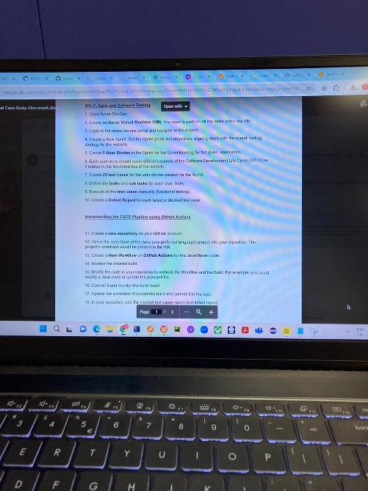
Learning is also Fun!
For this week, the fun activity was to develop user stories about a website, where we had to work in teams to develop fun user stories for this website, using these user stories we had to create acceptance criteria and test cases as well.
From this activity, I was able to learn the important concept of brainstorming in a team.

Slide 19

Summary
During this week’s Foundational Training, I was able to grasp the key concepts through which Business Analysts work and the working of Agile Scrum as an Agile framework with all its artifacts and ceremonies. I was also able to learn DevOps which is a culture to unite the development team and the operations team so that they can function as a single unit to streamline the whole SDLC process, I was able to grasp the basic concepts of DBMS which database should be used in what scenarios.
Next week we are going to learn about Frontend Development, .Net/C#, Application Security and Experience Design and Openhack all these topics are very important for an application implementation and security perspective.
Proper understanding of concepts such as Frontend Development helps to develop the user interacting part of any application which is important considering the business requirements, .Net/C# helps to implement the application while Application Security helps us to understand how to integrate security in design.

Slide 20
Thank You

